Slide 1
Image Retrieval Project AND AR project
Present by: InnoSoft

Slide 2
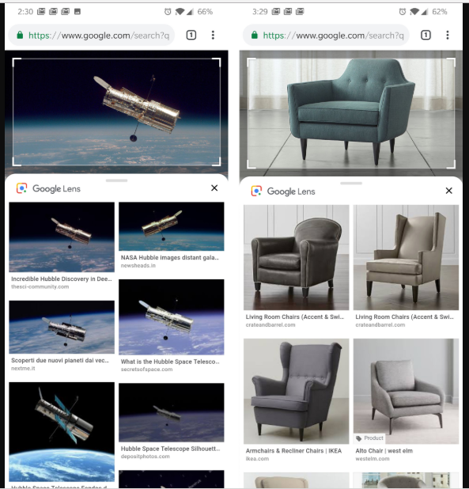
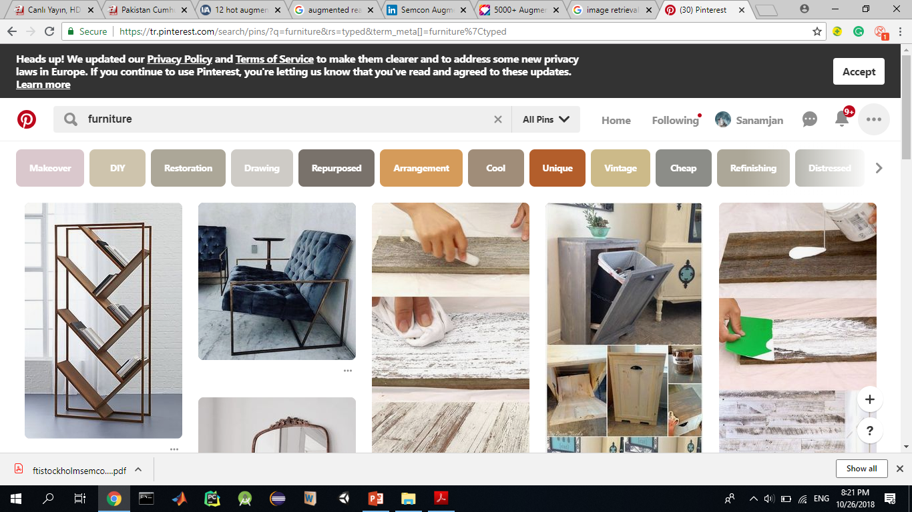
Pinterest and GOOGLE image search

Slide 3
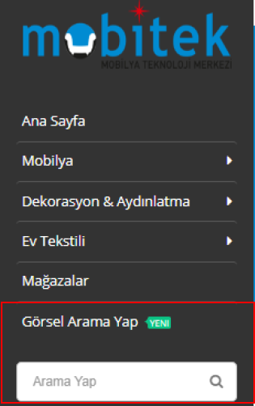
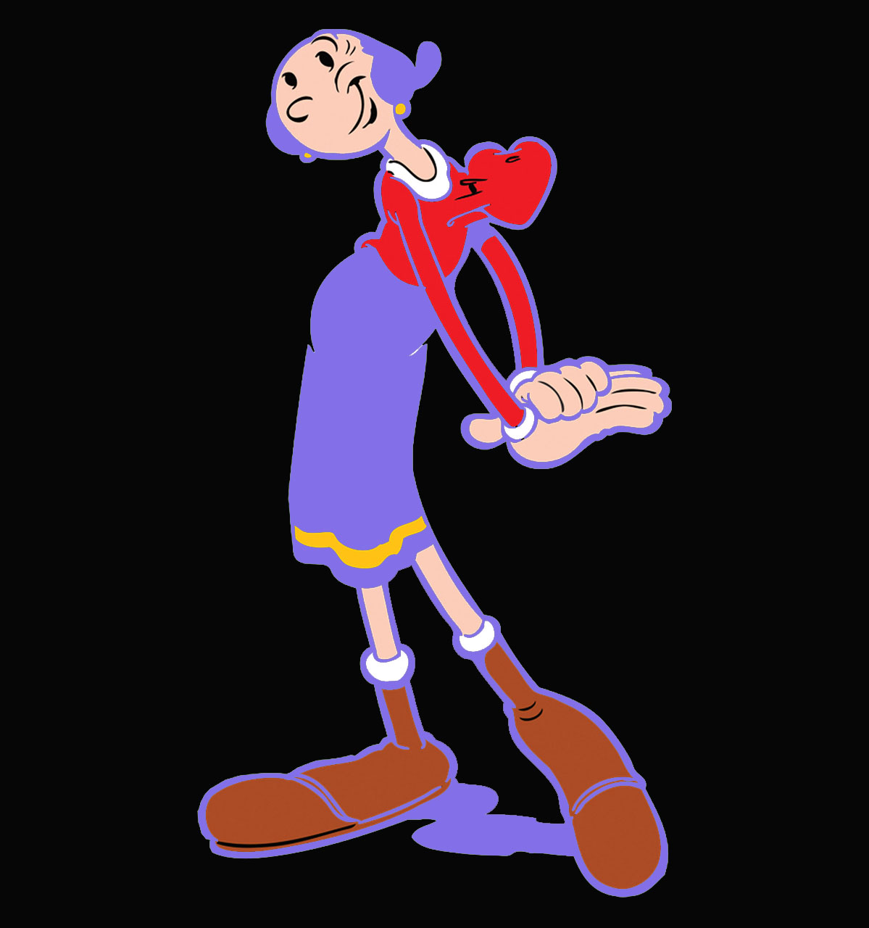
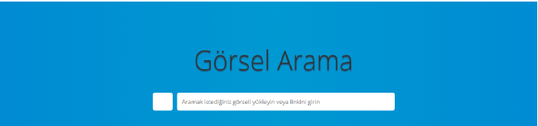
Mobitek Image SEARCH API

Slide 4
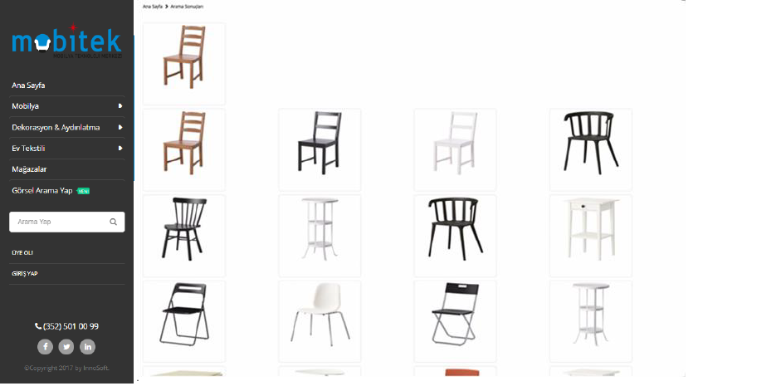

Mobitek Image SEARCH API

Slide 5
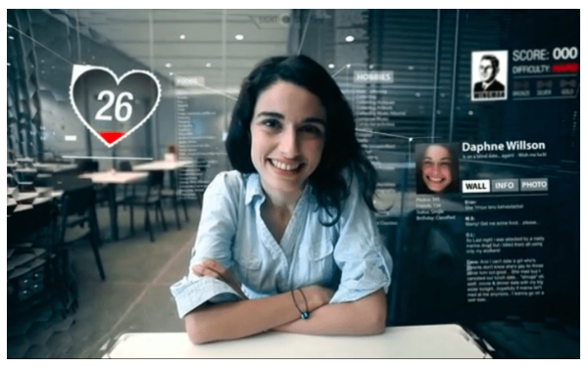
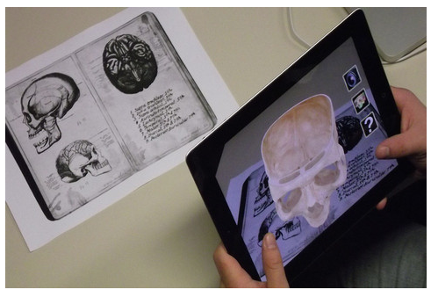
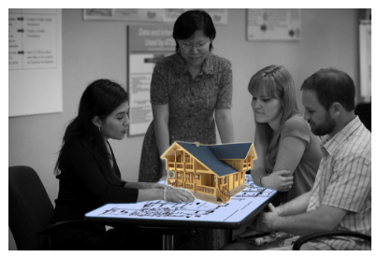
Augmented Reality
Unlike virtual reality that creates a fully virtual environment around a user, augmented reality integrates virtual objects into existing surroundings. This makes it more interactive and real.

Slide 6
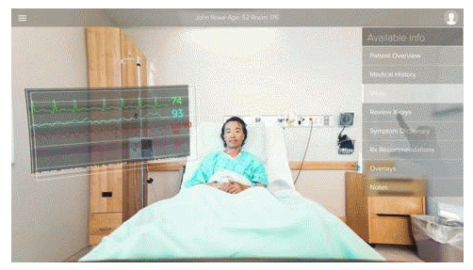
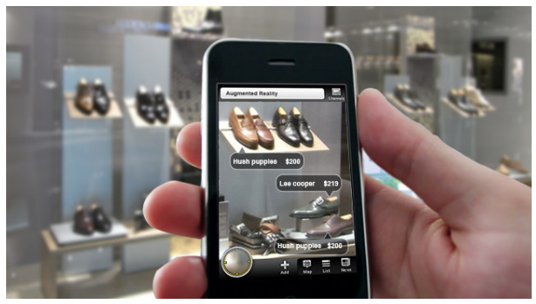
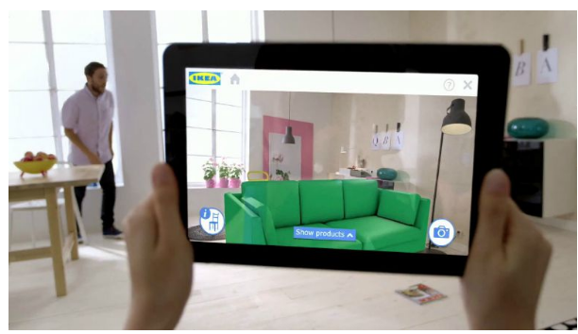
Augmented Reality

Slide 7
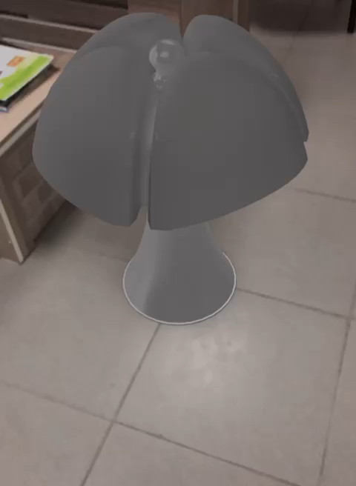
Furniture Shopping APP

Slide 8
Thank you

